Slide 2
Download & install bluej
https://www.dukelearntoprogram.com//course2/index.php

Slide 3
What is object-oriented language?
Object origented lanauge is a kind of programming language which associates with classes and objects
Classes are a way to organize your programs
Objects are created using classes when programming run

Slide 4

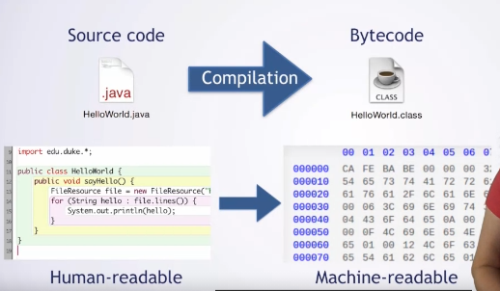
Continue…
Java is objected-oriented
Classes have .java file extension (this is also called source code)
Methods are contained in the class
Source codes are human-readable but not machine-readable
We need compile the source code (.java) to bytecode (.class)

Slide 5
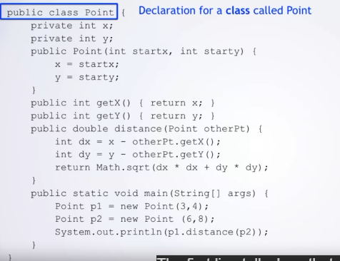
Class
A class is a template to make objects
Constructor: code run when an object is created to initialize the object
Method

Slide 6
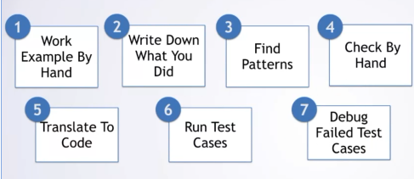
7 Steps of solving programming problems

Slide 7
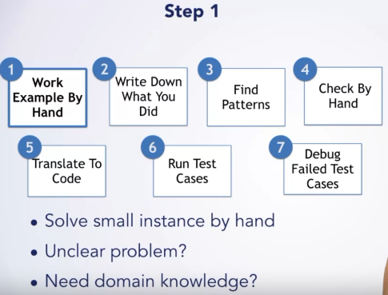
Step 1

Slide 8
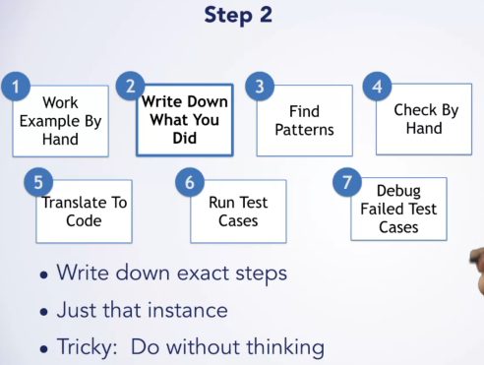
Step 2

Slide 9
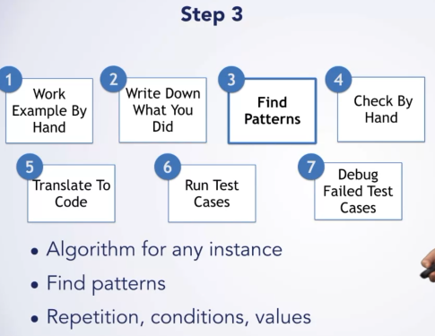
Step 3

Slide 10
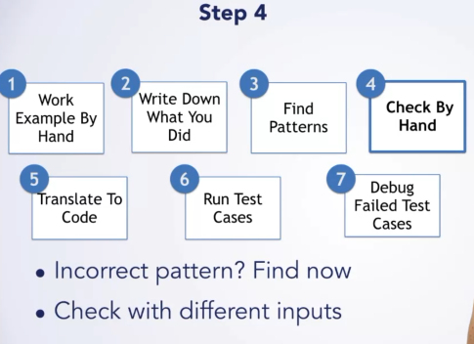
Step 4

Slide 11
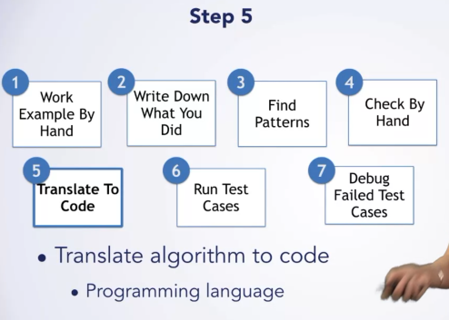
Step 5

Slide 12
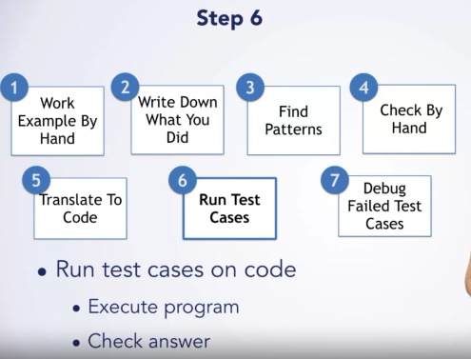
Step 6

Slide 13
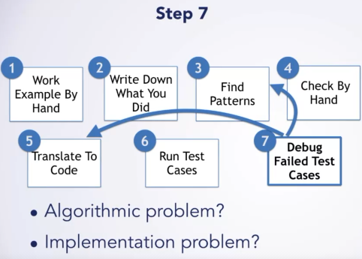
Step 7

